Slide 1
YARN

Slide 2
What is YARN?
YARN(Yet Another Resource Negotiator) is cluster resource management system for Hadoop.
YARN was introduced in Hadoop 2 to improve the MapReduce implementation and elluminate Hadoop 1 scheduling disadvantages.
YARN is a connecting link between high level applications(Spark,HBase e.t.c) and low level Hadoop environment.
With introduction of YARN, Hadoop transformed from only MapReduce framework to big data processing core.
Some people characterized YARN as a large-scale, distributed operating system for big data applications.

Slide 3
Anatomy of YARN
YARN provides its core services via two types of long-running daemon:
Resource Manager (one per cluster) is responsible for tracking the resources in a cluster, and scheduling applications. Actually it responses to resource requests from ApplicationMaster (one per each Yarn application), via requesting to Node Managers. It doesn’t monitor and collect any job history. It is only responsible for cluster scheduling. Actually ResourceManager is a single point of failure but Hadoop2 support High Availability which can restore ResourceManager data in case of failures.
Node Manager (one per every node) is responsible to monitor nodes and containers (slot analogue in MapReduce 1) resources such as CPU, Memory, Disk space, Network e.t.c. It also collect log data and report that information to the ResourceManager.

Slide 4
Contd…
Another important component of Yarn is ApplicationMaster
ApplicationMaster actually runs in a separate container process on a slave node.
It has one instance per application, instead of JobTracker, which was a single daemon that ran on a master node and tracked the progress of all applications which was a point of failures.
It responsible to send heartbeat messages to the ResourceManager with its status and the state of the application’s resource needs.
Hadoop2 supports uber (lightweight) tasks which can be run by ApplicationMaster on same node, without wasting time for allocation.
ApplicationMaster should be implemented for each Yarn application type, in case of MapReduce it designed to execute map and reduce tasks.

Slide 5
Steps to run Yarn application
Client does a request to ResourceManager to run application.
ResourceManager requests NodeManagers to allocate container for creating ApplicationMaster instance on available (which has enough resources) node.
When ApplicationMaster instance already run, it itself send requests (heartbeat, app resource needs e.t.c) to ResourceManager and manage application.

Slide 6
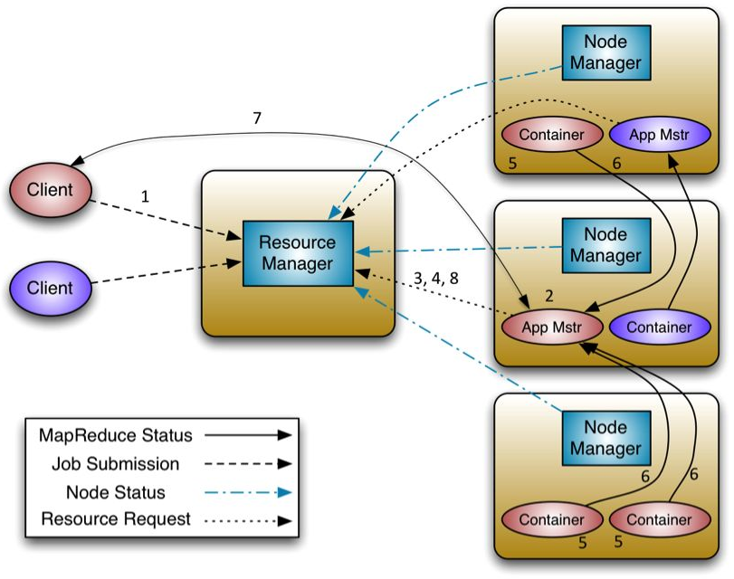

Slide 7
YARN Application
Hadoop 2 has a lots of high level applications that was written on top of the Yarn, by using Yarn API’s for example Spark,HBase e.t.c. MapReduce have also become an application on top of the Yarn.
Yarn and its applications concept brings flexibility and a lots of new opportunities for Hadoop environment.
It’s not easy but it possible to write, your own Yarn application if the existing Hadoop environment doesn’t satisfy your needs. More details about how you can write your own Yarn application you can find by link below. http://twill.incubator.apache.org/

Slide 8
MAPREDUCE 2 VS MAPREDUCE 1
MapReduce 2 became an application on top of the YARN, which use Yarn to manage resources. We look at advantages of MapReduce 2 below:

Slide 9
MAPREUCE2 Advantages
Has three schedulers for shared (between users and jobs) cluster resource allocation. FIFO, Capacity a Fair schedule.
It supports Uber tasks which can be run by ApplicationMaster in same node without wasting time for resource allocation
Use ResourceManager(one per cluster) with High Availability support. And also run ApplicationMaster(one per application instance)
Supports different version of MapReduce in single cluster.
Separate JobHistory daemon.

Slide 10
MAPREDUCE1- Disadvantages
Has underutilization problem because it support only FIFO scheduler. Here sharing unit is slots (fixed par.) container(dynamic par.)
Doesn’t support Uber tasks.
JobTracker(one for all application) single point of failure.
Supports only one version of MapReduce per cluster.

Slide 11
Scheduling in YARN
Scheduling is an important task when Hadoop cluster is shared between many users and tasks. Problem is which user’s task should be run first or which task should be run first, big one or small one.
Hadoop 1 which use FIFO scheduler with slot (fixed cpu, memory and disk count) based model was very inefficient for shared clusters, whereas Hadoop 2 introduced Capacity (by Yahoo) and Fair (by Facebook) schedulers with container (dynamic cpu, memory and disk count) allocation model as part of the Yarn, which is more efficient than FIFO scheduler.
Yarn supports three schedulers FIFO, Capacity and Fair schedulers. It also provide opportunity to create your own scheduler by extending Fair scheduler class.

Slide 12
Contd…
FIFO - First Input First Output:
the simplest and most understandable scheduler
It doesn’t need any configuration.
But it’s not suitable for shared clusters because big applications eat all resources.

Slide 13
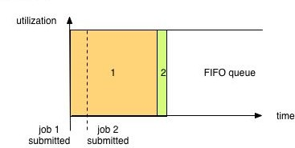
Contd…

Slide 14
Capacity Scheduler
Capacity scheduler - allows sharing of a Hadoop cluster along organizational lines (each one is a queue). Queues may be further divided in hierarchical fashion.
each organization is allocated a certain capacity of the overall cluster.
if there is more than one job Capacity Scheduler may allocate the spare resources to jobs in the queue, even if that causes the queue’s capacity to be exceeded. (queue elasticity.)
when demand increases, the queue will only return to capacity as resources are released from other queues as containers complete. If it’s not have configured policy

Slide 15
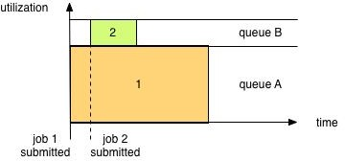
Contd…

Slide 16
Fair Scheduler
Fair Scheduler dynamically balance resources (evenly between all tasks) between all running jobs. There is also queue hierarchy for organisations.
If queue policy is not configured it is Fair (50/50% or 1:1)
Preemption allows the scheduler to kill containers for queues that are running with more than their fair share of resources
Delay scheduling allows allocating container in same node where application was submitted.
Dominant Resource Fairness (drf) gives priority to tasks which have the most dominant resources

Slide 17
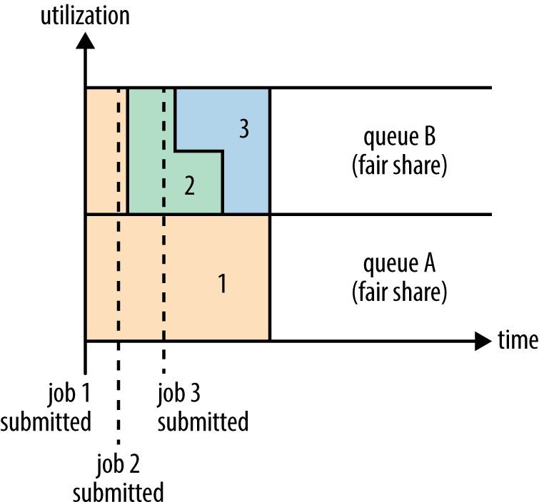
Contd…

Slide 18
Some YARN using Tips
If you want to:
determine the configuration of your cluster fast and easy, just view the configuration using the ResourceManager UI by web browser.
run a Linux command in your Hadoop cluster (with Yarn), simply use the DistributedShell application bundled with Hadoop.
access container log files (only log files contain actual result of your command which have been run), use YARN’s UI and the command line to access the logs.
aggregate container log files (which by default in local FS on NodeManager where container was run.) to HDFS and manage their retention policies, just use YARN’s built- in log aggregation capabilities options.
use MapReduce code that isn’t binary compatible with MapReduce 2, and you want to be able to update your code in a way that will be compatible with both MapReduce versions. Just use a Hadoop compatibility library that works around the API differences.

